Slide 1




ASIA PACIFIC ACCREDITATION COOPERATION
Acceptance | Equivalence | Competence
www.apac-accreditation.org
secretariat@apac-accreditation.org

Slide 2
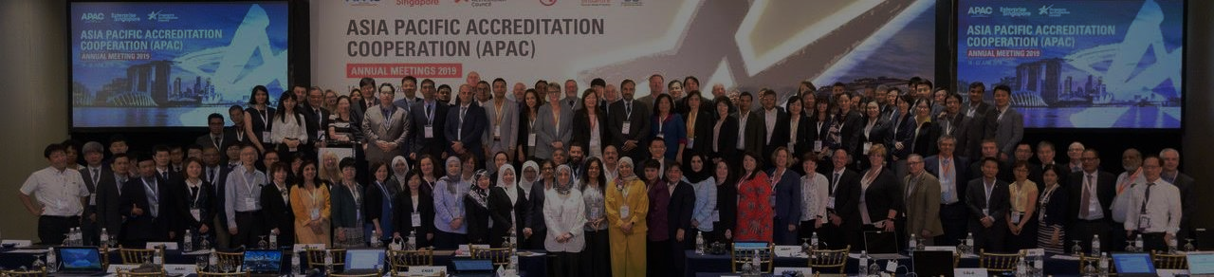
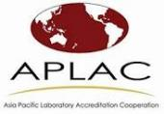

About APAC
The Asia Pacific Accreditation Cooperation (APAC) was established on 1 January 2019 by the amalgamation of two former regional accreditation cooperation – the Asia Pacific Laboratory Accreditation Cooperation (APLAC) and the Pacific Accreditation Cooperation (PAC).

Slide 3


OBJECTIVES OF APAC
To facilitate the reduction of technical barriers to trade by promoting acceptance of the results of conformity assessment activities from conformity assessment bodies that are accredited by Full Members
To provide formal recognition of accreditation bodies in the Asia Pacific Region and to establish and maintain recognition by other international and regional organisations
To provide a forum for exchange of information and to promote discussion among accreditation bodies and among organisations that have an interest in accreditation, and related activities
Maintaining recognition through the International Accreditation Forum (IAF) and International Laboratory Accreditation Cooperation (ILAC), and as a Regional Group to cooperate and complement activities of other Regional Groups with IAF and ILAC.

Slide 4



Role of APAC and Members
APAC Members
APAC’s members include accreditation bodies, accreditation focal points and other organizations that have an interest in accredited conformity assessment results.
Role of APAC
APAC ‘s primary role is to manage and expand a mutual recognition arrangement (MRA) among accreditation bodies in the Asia Pacific region. The MRA facilitates the acceptance of conformity assessment results (e.g. test reports, test certificates, inspection reports, and certification) across the region and with other regions around the world.
APAC Recognition
APAC is recognized by the Asia Pacific Economic Cooperation (APEC) as one of four APEC Specialist Regional Bodies (SRBs) that support the work of the APEC Sub-Committee on Standards and Conformance.

Slide 5

APAC Structure
APAC has the following structure:
APAC General Assembly (GA)
APAC Secretariat
Executive Committee (EC)
MRA Management Committee (MRAMC)
Technical Committee (TC) 1 Laboratories, Inspection, Reference Materials, Proficiency Testing
MRA Council
Subcommittee on Proficiency testing
Technical Committee (TC) 2 Certification, Validation and Verification
Capacity building Committee (CBC)
Communication and Promotion Committee (CPC)

Slide 6








APAC Secretariat
APAC Chair
Ms. Chang Kwei Fern (SAC – Singapore)
APAC Vice-Chair
Ms. Jennifer Evans (NATA – Australia)
MRA Council Chair
Mr. Trace McInturff (A2LA – USA)
Capacity Building Committee
Mr. Brahim Houla (GAC-GCC Member States ), Chair
Communications and Promotion Committee
Dr. Aparna Dhawan (NABCB, India), Chair
Technical Committee 2 Ms. Kathryn Lockyer
(JAS-ANZ – Australia and New Zealand), Chair
Technical Committee 1 Mr. Adam Gouker (A2LA – USA), Chair
APAC Secretary
Mr Graeme Drake

Slide 7





APAC MEMBERS
APAC Members are designated into categories of Full Members, Associate Members and Affiliated. Below are the Number of APAC Members and Affiliates from different economies:
Associate Members across 13 economies
17
48
Full Members across 29 economies that are APAC MRA signatories
17
Affiliates across 6 economies

Slide 8
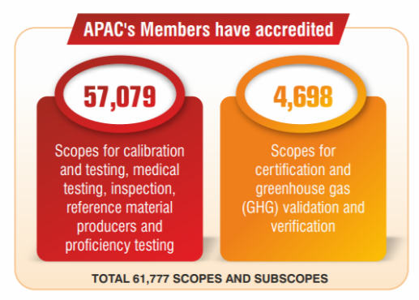
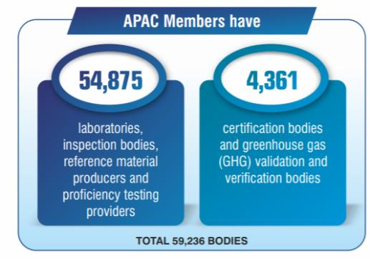
APAC MRA Members (as of Sep 2019)
APAC MRA Signatories Scope
147
166
58822
5109
Total of 313 Scope and Sub scope
Total of 63931 CAB with accredited scope
Notes:
Scope of accreditation is the specific conformity assessment activities for which accreditation is sought or has been granted. A scope of accreditation for a testing laboratory may identify the specific tests or types of tests; an inspection scope may identify the type of inspections, etc.
There may be more scopes and certificates than accredited bodies within APAC because an accredited organization may hold more than one accreditation in several conformity assessment types.

Slide 9

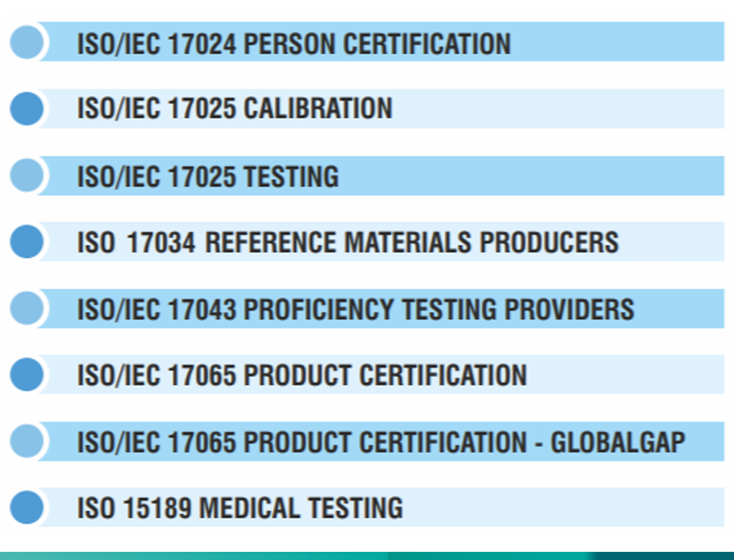
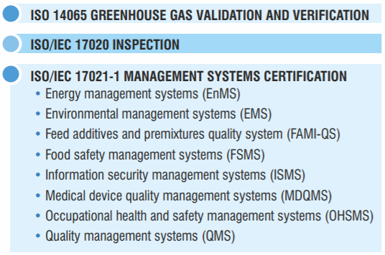
ISO 20387 BIOBANKING
Notes:
The APAC MRA is based on the results of an intensive evaluation of each accreditation body done in accordance with procedures detailed in the relevant APAC publications. Each APAC MRA signatory has demonstrated conformity with the international standard for accreditation bodies, ISO/IEC 17011, and its accredited facilities are in conformity with one or more of the following conformity assessment body standards:

Slide 10


APAC PARTNERSHIP
APAC is recognized by ILAC and IAF allowing acceptance of conformity assessment reports at international platform.
APAC also has partnership with other regional bodies like:
  Inter-American Accreditation Cooperation (IAAC)
  European co-operation for Accreditation (EA)
  Asia Pacific Accreditation Cooperation Incorporated (APAC)
  Arab Accreditation Cooperation (ARAC)
  African Accreditation Cooperation (AFRAC)
APAC is recognized by the Asia Pacific Economic Cooperation (APEC) as one of four APEC Specialist Regional Bodies (SRBs) that support the work of the APEC Sub-Committee on Standards and Conformance.
APAC has liaisons with International Organization for Standardization (ISO), International Bureau of Weights and Measures (BIPM), Asia Pacific Metrology Program (APMP), World Trade Organization (WTO)

Slide 11





BENEFITS OF APAC ACCREDITATION
Creating Trust and Public Confidence
Accreditation provides customer confidence in the market as the products and services chosen by them as they are assessed by an independent and competent conformity assessment body in an impartial manner.
Ensuring Quality and Safety
APAC mutual recognition ensures that goods and services placed on the market irrespective of area of origin, meet standards of quality and safety minimizing failures.
Providing Competitive edge
Customer confidence in APAC mutual recognition will provide users of conformity assessment bodies with competitive edge as it ensures technical competence.
Facilitating Global Trade
Mutual Recognition to APAC facilitates the acceptance of conformity assessment results across the region, thus contributing to the facilitation of trade and the free-trade goal of “tested / inspected / certified once, accepted everywhere”.
Supporting Regulators and Stakeholders
The APAC MRA provides an opportunity to regulators and stakeholders to use services of accredited conformity assessment bodies as it ensures the quality of the product and services by demonstrating the compliance against agreed standards and requirements and following harmonized approach across region.

Slide 12




How does an organization become a member of APAC
Organizations wishing to become an APAC Member or Affiliate are advised to read the Governance (GOV) documents, especially GOV-001 APAC Constitution and GOV-002 APAC Regulations and Codes, the Mutual Recognition Arrangement (MRA) documents on the APAC website. If your organization is suitable then please make contact with the APAC Secretariat (secretariat@apac-secretariat.org) to discuss your situation further.
Where can I find a list of accredited facilities in a particular economy
Please go to the specific website of the relevant APAC member as displayed on the Membership page. You should be able to navigate to a directory or list of accredited conformity assessment bodies on that member’s website.

Slide 13




THANK YOU!!!
Asia Pacific Accreditation Cooperation Incorporated (APAC)
PO Box 5154
South Turramurra
NSW 2074
Australia
+61 466 262 372
secretariat@apac-accreditation.org

