Slide 1






APAC MEMBERS
APAC Members are designated into categories of Full Members, Associate Members and Affiliated. Below are the Number of APAC Members and Affiliates from different economies:
Associate Members across 14 economies
18
48
Full Members across 29 economies that are APAC MRA signatories
6
Affiliates across 6 economies

Slide 2
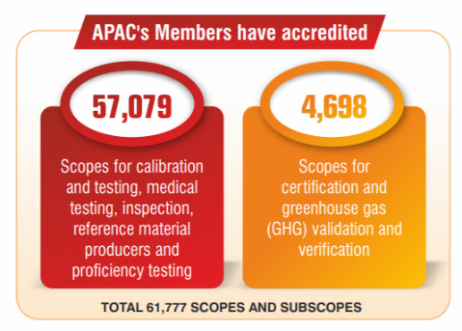
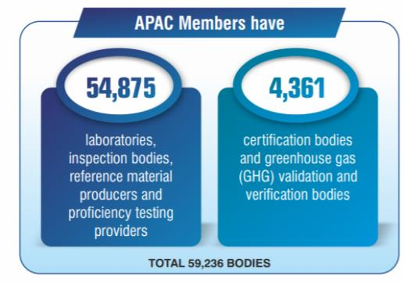
APAC MRA Members (as of Jun 2020)
APAC MRA Signatories Scope
150
173
58822
5109
Total of 323 Scope and Sub scope
Total of 63931 CAB with accredited scope
Notes:
Scope of accreditation is the specific conformity assessment activities for which accreditation is sought or has been granted. A scope of accreditation for a testing laboratory may identify the specific tests or types of tests; an inspection scope may identify the type of inspections, etc.
There may be more scopes and certificates than accredited bodies within APAC because an accredited organization may hold more than one accreditation in several conformity assessment types.

